Slide 1
Implementing Section 23a Dropout Recovery
Programs
A District Training for Proper Implementation,
Compliance & Funding
Michigan Department of Education | 2025-26 Pupil Accounting Manual

Slide 2
What Is a Section 23a Dropout Recovery Program?
Section 23a programs re-engage students outside the traditional K-12 system
Target Populations
Instructional Model
Section 23a Dropout Recovery Programs are year-round
alternative education programs designed to serve two distinct populations:
Unlike traditional seat-time models, these programs use
personalized, competency-based instruction that emphasizes:
•
Academic credit recovery*
Pupils who have already left the traditional K-12 system without earning a high school diploma
•
Progress toward graduation
•
Pupils who are at risk of dropping out without district intervention
Sustained engagement through flexible instructional pathways
•
•
*This is not a replacement for summer credit recovery programs as those programs are open to additional eligible students.
These programs operate under a distinct statutory funding and membership framework defined in MCL 388.1623a of the State School Aid Act.

Slide 3
Who Qualifies as an Eligible Pupil?
Six eligibility categories define who may be served under Section 23a
A pupil must meet at least one of the following criteria to be enrolled and claimed for membership under Section 23a (MCL 388.1623a(3)(c)):
Eligibility Category Description
Mandatory Expulsion Expelled under MCL 380.1311 or 380.1311a
Local Suspension/Expulsion Suspended or expelled under local policy
Court Referral Referred by a court
Pregnant or Parent Currently pregnant or is a parent
Previous Dropout Has previously dropped out of school
At-Risk Determination Determined by the district to be at risk of dropping out
Key Point
The district is responsible for documenting each pupil's eligibility category. Pupils may also qualify under the "extreme barriers to education" provisions (e.g., foster care, homelessness, poverty, refugee status, ESL) to allow for two additional years of eligibility by age.

Slide 4





13 Requirements Every Program Must Meet
Compliance requires satisfying all 13 statutory program requirements
To qualify for special membership counting provisions, a Section 23a program must meet all of the following (per MCL 388.1623a(1) and the 2025-26 PAM):
1 Enroll only eligible pupils 2 Assign a certified teacher of record
3 Provide an advocate (max 50 pupils per advocate)
4 | Develop a written personalized learning plan | 5 | Monitor pupil progress against the written | 6 | Require satisfactory monthly progress from
 | before the first school day of the first month |  | learning plan |  | each pupil
7 | If using an EMO, report pupil progress to the district at least monthly | 8 | Operate on or off campus; online-only requires providing a computer and internet | 9 | Operate throughout the entire calendar year (12 months)
 |  |  | access to each pupil
10 | If using an EMO, the EMO must partner with at least one other district | 11 | Background checks required for all advocates and teachers of record (MCL 380.1230 and 380.1230a) | 12 | Report enrollment and full attendance to CEPI within 30 days after the end of each month
13 Flag the building as an alternative education provider in CEPI's Educational Entity Master (EEM)
14* For students with extreme barriers, use participation code 9222 in MSDS and add the PCE setting to the assigned building in the EEM.

Slide 5
The Advocate Role Is Critical
Every enrolled pupil must be assigned a qualified advocate
The advocate is a cornerstone of the Section 23a program model. By statute (MCL 388.1623a(3)(a)), an advocate is:
"
An adult available to meet in person with assigned pupils, as needed, to conduct social interventions, to proctor final examinations, and to provide academic and social support
.
Key Requirements for Advocates
Must be available to meet in person with assigned pupils
May serve no more than 50 pupils at one time
May be employed by the district or provided by an Education Management Organization (EMO)
Must pass background checks per MCL 380.1230 and 380.1230a before being assigned to any pupil
Practical Guidance
Districts should maintain documentation showing the advocate-to-pupil ratio and ensure advocates are actively engaged in monthly progress reviews and intervention planning.

Slide 6
The Written Learning Plan - A Non-Negotiable Requirement
A written learning plan must be in place before the first school day of a pupil's first month
Required Elements
Timing Requirement
The WLP must be in place on or before the first school day of the month for the first month the pupil participates in the
program.
Without a valid WLP, the pupil cannot be reported as being in full attendance and cannot generate membership.
The Written Learning Plan (WLP) is a statutory requirement and must be developed in conjunction with the advocate. It must
include all of the following elements (MCL 388.1623a(3)(f)):
Plan start and end dates Courses to be taken
Credit to be earned for each course
Teacher of record for each course
Advocate's name and contact information
Best Practice
Develop a standardized WLP template and establish a workflow to ensure all plans are completed and documented before
enrollment begins each month.

Slide 7
Understanding "Full Attendance" Under Section 23a
Full attendance has a specific statutory definition not simply showing up
A district shall not report a pupil as being in full attendance for a month unless BOTH of the following are satisfied (MCL 388.1606(4) (dd)):
Condition 1: Written Learning Plan
A personalized learning plan is in place on or before the first school day of the month for the first month the pupil participates in the program.
Condition 2: Progress Requirement (One of the following must be true)
(A)
The pupil meets the district's definition of satisfactory monthly progress for that month; OR if the pupil did not meet it, they met it the prior month AND appropriate interventions are implemented within 10 school days.
OR
(B)
For the first 2 months of enrollment, the pupil earns at least 0.25 credit by the end of the second month (the first month may be retroactively reported as full attendance once the 0.25 credit threshold is met).
Warning
To be eligible for membership, student’s must satisfy one of the above conditions as well as be in full attendance for the month.
Notes:
Full attendance means each day, including the first day of the month.

Slide 8
Satisfactory Monthly Progress Defined
Satisfactory monthly progress must be measurable and lead to a full year's credit if sustained
STATUTORY D EFI NI TI ON (MCL 388.1623A(3)(d ))
"An amount of progress that is measurable on a monthly basis and that, if continued for a full 12
months, would result in the same amount of academic credit being awarded to the pupil as would be awarded to a general education pupil completing a full school year."
What This Means in Practice
A general education pupil typically earns approximately
6 credits per year
District Responsibility
Each district must adopt a written definition of
satisfactory monthly progress consistent with the
statutory definition (MCL 388.1623a(2)). This definition must be documented and applied consistently.
Therefore, satisfactory monthly progress equates to approximately
0.5 credits per month
For first 2 months, a lesser amount is allowed but the pupil must earn
at least 0.25 total
credits by the end of month 2

Slide 9
Membership Counting and FTE How It Works
Section 23a uses a monthly 1/12 FTE model — not the traditional fall/spring count
HOW MEMBERSHIP IS CALCULATED
IMPORTANT RESTRICTION
Pupils maybe not be claimed under Section 23a and through the traditional counts during the fall and spring.
If a district wishes to claim a pupil in the fall or spring count, that pupil must satisfy all general
education membership requirements for that count period.
Each eligible pupil in full attendance generates 1/12 of a full-time equated (FTE) membership per month
Alternatively, membership may be based on successfully completion of courses, with each course equal to 1/12 FTE.
A district may claim more than 1/12 FTE if a pupil was in full attendance and successfully completes more than one course during a month.
TRADITIONAL FTE FORMULA
Number of students claimed × 1/12 = 23a FTE
MODIFIED FTE FORMULA
Number of courses completed × 1/12 = 23a FTE

Slide 10
FTE Cap, Section 25g, and Proration
FTE above 1.0 is paid through Section 25g — and is typically prorated
FTE Range Payment Source Notes
0 - 1.0 FTE Foundation allowance (Sections 22a & 22b) Standard payment at district's per-pupil amount
1.0 - 1.25 FTE Section 25g categorical funding Prorated based on available funds
Above 1.25 FTE No payment — permanent deduction Overclaimed amounts are deducted at year-end
CRITICAL WARNING
Section 25g was funded at $750,000 annually (unchanged for many years), which led to significant prorations until 2024-25 when the amount was increased to $3,050,000.00; prorations were ~.951 with that allocation. For 2025-26, the amount decreased to $1.25M. Going forward, worst case scenario, reverts back to 750k. Districts should budget funds tied to the FTE over 1.0 up to 1.25 (the additional 0.25) accordingly.
YEAR- END RECONCILIATION
The department performs a manual adjustment each October,
deducting FTE over 1.0 from foundation and reimbursing from 25g (prorated). This will appear as a prior-year adjustment on the following year’s payment.

Slide 11
Reporting Deadlines
The 30-day reporting deadline is absolute
STATUTORY REQUI REMENT (MCL 388.1606(4)(dd ))
The district operating the program shall report to the center the number of pupils who were enrolled in the program and were in full attendance for a month not later than 30 days after the end of the month.
Key Reporting Facts
Action Item
Establish an internal calendar with 30-day deadlines for each month of the program year (July through
June) and assign a backup staff member to ensure continuity during staff absences.
Reports are submitted through CEPI’s Michigan Student Data System (MSDS) via the Student Record Maintenance (SRM) collection
No exceptions are permitted - submissions after the 30-day deadline are not accepted
Districts must be especially vigilant during summer months when staff may be on vacation or experiencing turnover
Monitor CEPI communications for system outages; registered users receive advance notice via newsletter

Slide 12
How to Report - CEPI and MSDS
All Section 23a membership is reported through CEPI's MSDS Student Record Maintenance system
STEP- BY- STEP REPORTING PROCESS
CEPI CONTACT INFORMATION
Website: michigan.gov/cepi Email: CEPI@michigan.gov
Phone: (517) 335-0505, option 3
1
Log in to the Michigan Student Data System (MSDS) at michigan.gov/cepi
2
Ensure the building is flagged as an alternative education program provider in the Educational Entity Master (EEM)
3
Ensure enrolled pupils are flagged as alternative education pupils in MSDS
IMPORTANT NOTE
No registration with MDE is required before starting a Section 23a program.
However, proper CEPI system setup is mandatory before claiming membership.
4
Submit monthly enrollment and full attendance data through the Student Record Maintenance (SRM) collection
5
For multiple courses completed in a month, refer to CEPI guidance at michigan.gov/cepi/pk-12/msds/srm

Slide 13
Partnering with an Education Management Organization (EMO)
Districts may partner with an EMO, but must retain full control over enrollment
An Education Management Organization (EMO) is defined as a private provider that operates one or more dropout recovery programs meeting Section 23a requirements in partnership with one or more districts (MCL 388.1623a(3)(b)).
WHAT AN EMO MAY DO
Advertise the program
Provide advocates and teachers of record
WHAT THE DISTRICT MUST RETAIN
Full control over student enrollment — vendors must not enroll students on the district's behalf
Responsibility for maintaining student records and all administrative tasks
MUST Report student progress to the district monthly
Provide varying levels of program support
Oversight of all compliance and reporting obligations
Contract documentation (required for annual end-of-year reporting) – MCL 380.1230i
STATUTORY REQUIREMENT
If partnering with an EMO, the EMO must have a dropout recovery program partnership relationship with at least one other district.

Slide 14
District Responsibilities vs. EMO Responsibilities
Clear role separation between the district and EMO prevents compliance failures
Responsibility | District | EMO
Student enrollment in MSDS | District only | ×
Background checks for advocates/teachers | District must verify | May employ
Written learning plan development | Must be in place | May assist
Monthly progress monitoring | Must oversee | Reports to district
CEPI reporting (SRM submissions) | District only | ×
Student recruitment | ✓ Primary | May assist
Instruction delivery | May employ certified teachers | May provide
Advocate services | May employ | May provide
Annual end-of-year MDE reporting | District only | ×
BOTTOM LINE
The district is legally responsible for all compliance.. Delegating enrollment or reporting to a vendor creates audit risk and potential funding claw backs…

Slide 15
End-of-Year Reporting Obligation (MCL 380.1230i)
Districts must submit annual program data to MDE each June
Effective January 31, 2020, all districts operating a Section 23a program must annually report the following to MDE (MCL 380.1230i):
Number of eligible pupils enrolled
Average number of months a pupil is enrolled
Number of pupils who earned a diploma through the program
Number of pupils who ended enrollment and re-enrolled in a public school
Average credit hours earned per pupil
Breakdown of pupils by eligibility category
Name of the EMO partner (if applicable)
Amount paid to the EMO per enrolled pupil (if applicable) and any additional fees
Name of the district administrator overseeing the program
Copy of the contract with the EMO (if applicable)
SUBMISSION DETAILS
Portions of this data are reported through an MDE form at the conclusion of the school year in June.. Remaining data is aggregated from other reported sources..

Slide 16
Verifying Your 23a Funding — Step by Step
Districts should reconcile MSDS data against the State Aid Status Report monthly
1
Pull the 23a Summary from MSDS
2
Calculate FTE
3
Reconcile to the State Aid Status Report
Log in to MSDS → Certified Data Reports → Certified Reports
Create a pivot table with Month Claimed as the row and count as set to the UIC
Access the State Aid Financial Status Report at michigan.gov/sasf
■
Select the SRM Collection for the current year
Multiply total students per month × 1/12 = monthly FTE
■
■
Locate your district and compare cumulative 23a FTE to the MSDS calculation
■
Choose "Section 23a Summary" report in Excel format
Calculate cumulative by adding each month's FTE to the prior total
■
■
Pull a second file for the prior year to capture July and August records (the 23a program year runs July–June,
while SRM aligns with the school year)
Note: A slight lag may occur depending on submission timing; FTE should catch up in subsequent months.

Slide 17
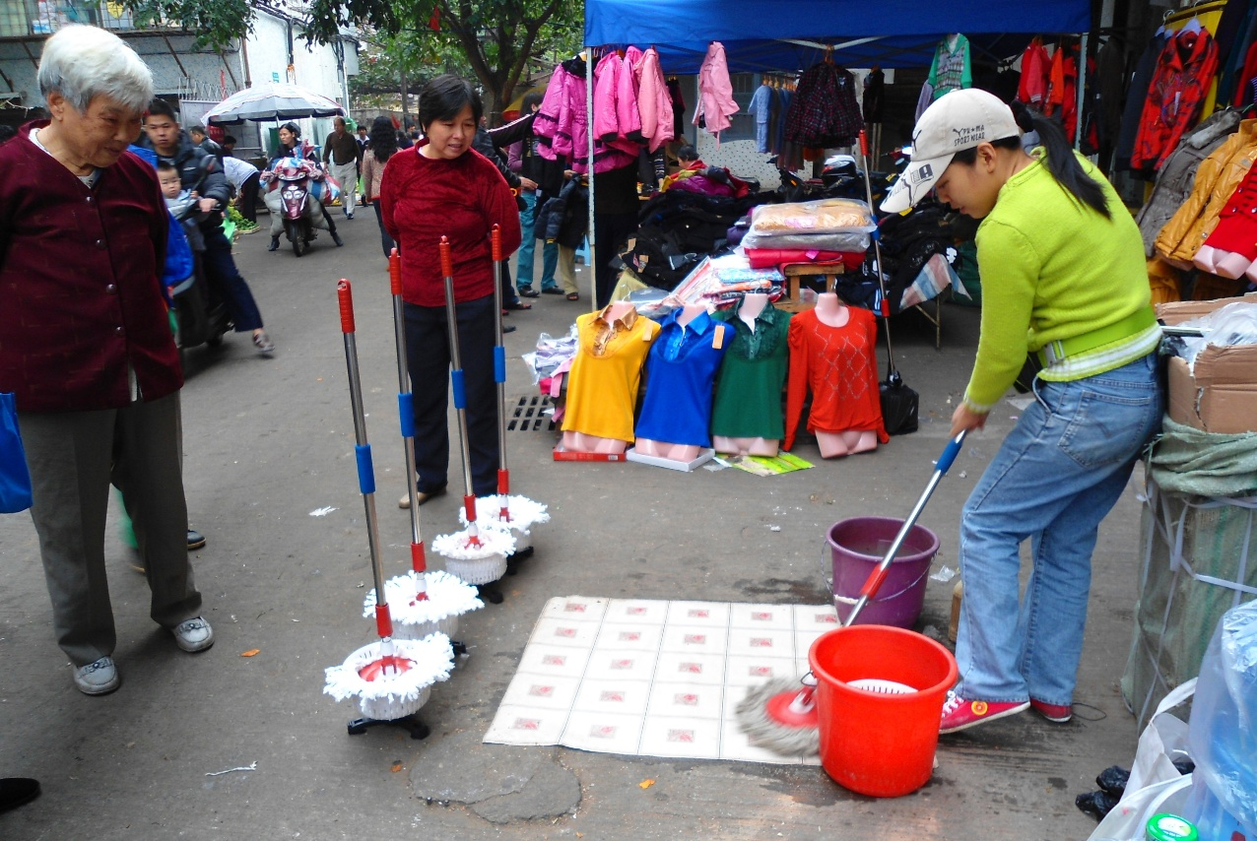
Verifying Your 23a Funding — Step by Step (demonstration)
Jessica will now provide a demonstration of how districts might reconcile their 23a program participation against their status report.

Slide 18
This year requires additional attention….
Jessica will now provide a demonstration of how districts might reconcile their 23a program participation against their status report
Required Data Fields for Verification: Districts That Used Option 2
For each student claimed for Section 23a funding from July 2025 through June 2026, districts must provide:
District Code
UIC
Month Claimed in 23a Component
Month SRM Reported to CEPI
Course Name and Local Course Code
Course Completion Date
Number of Courses Required to Be Full‑Time in a Year
Qualifier (basis for the claim):
- Satisfactory monthly progress
- No improvement but interventions provided within 10 days
- Reduced progress allowed during first two months
- Multiple course completions
Total Section 23a FTE Claimed for the Student

Slide 19
Common Compliance Pitfalls to Avoid
These are the most frequent compliance errors districts make in Section 23a programs
TOP COMPLIANCE RISKS
1
Missing or late written learning plans WLP must be in place before the first
school day of the pupil's first month; retroactive creation is not permitted.
2
Reporting full attendance without satisfactory progress
Districts must document that progress was met or that a 10-day intervention
plan was implemented.
3
Missing the 30-day reporting deadline No exceptions; late submissions are
permanently lost.
4
Allowing EMOs to enroll students Enrollment must be conducted by district personnel.
5
Exceeding the 1.25 FTE cap
FTE over 1.25 results in a permanent deduction with no reimbursement.
6
Advocate-to-pupil ratio violations
Each advocate may serve no more than
50 pupils.
7
Failing to operate year-round
The program must run all 12 calendar months.
8
Not flagging pupils as alternative education in MSDS
Pupils must be properly coded before membership can be claimed.
9
Counting a pupil in both 23a and the general collection
Claiming a pupil in both for the same month is prohibited.
Notes:
One compliance issue that is not highlighted related to student eligibility.

Slide 20
Key Statutory References
Know your legal authority — these statutes govern every aspect of Section 23a
MCL 388.1623a
Core Section 23a program requirements and definitions
MCL 388.1625g
Section 25g categorical funding for FTE over 1.0
MCL 388.1701
General State School Aid Act provisions
MCL 380.1230 / 380.1230a
Background check requirements for advocates and teachers
MCL 388.1606(4)(dd)
Membership counting provisions and full attendance definition
MCL 388.1622a / 388.1622b
Foundation allowance payment provisions
MCL 380.1311 / 380.1311a
Mandatory expulsion provisions (eligibility)
MCL 380.1230i
Annual end-of-year program reporting obligation
KEY RESOURCES
2025-26 Pupil Accounting Manual, Section 5-Q-A
CEPI MSDS Collection Details Manual— Section 23a Component
MDE 23a Program Resource Document

Slide 21
Action Checklist for Districts
Use this checklist to ensure your program is properly set up and compliant
BEFORE LAUNCHING
MONTHLY OPERATIONS
ANNUALLY
Flag building as alternative education provider in CEPI EEM
Ensure WLPs are in place before the first school day of each new pupil's first month
Submit end-of-year program data to MDE in June (MCL 380.1230i)
Adopt a written definition of
satisfactory monthly progress
Review and update the program's satisfactory monthly progress
definition
Monitor and document each pupil's satisfactory monthly progress
Establish WLP template and completion workflow
Implement interventions within 10 school days if a pupil misses a
progress target
Audit advocate-to-pupil ratios and background check documentation
Complete background checks for all advocates and teachers of record
Submit SRM report to CEPI within 30 days of the end of each month
If using an EMO, verify the EMO partners with at least one other
district and execute a written contract
Reconcile MSDS data to State Aid Status Report
Develop a calendar

Slide 22
Summary and Key Takeaways
Proper implementation protects students, ensures compliance, and maximizes funding
THE FIVE PILLARS OF A COMPLIANT PROGRAM
REMEMBER
Section 23a provides a powerful, flexible funding mechanism to serve students who need it most. Proper implementation ensures those students receive the support they deserve — and that your district receives the funding it has earned.
1
Eligible pupils
Document every student's eligibility category before enrollment
2
Written learning plans
In place before the first school day; updated and monitored monthly
3
Satisfactory monthly progress
Defined in writing by the district; measured and
documented every month
4
Timely reporting
30-day deadline to CEPI is absolute; build internal
systems to ensure compliance
QUESTIONS? CONTACT:
CEPI
CEPI@michigan.gov | (517) 335-0505, option 3
District control
The district is legally
responsible; never delegate enrollment or reporting to a vendor
State Aid School Finance: michigan.gov/sasf
5
MDE Pupil Accounting: mde-sasf@michigan.gov

