Slide 1

State Aid Update: Pupil Accounting & Compliance
2025–2026 School Year
Brian Ciloski, MDE
Jessica Beagle, MDE
Notes:
Today's session focuses on the practical implications of changes for the 2025–2026 school year. We won't just review the manual; we'll dive into what these updates mean for your funding and audit outcomes. Our goal is to give you a clear understanding of the risks and how to ensure compliance this year.

Slide 2

Four Areas of Focus Today
01
02
PAM Updates
Legislative Changes
Key revisions to the Pupil Accounting Manual
Statutory updates affecting membership & attendance
03
04
High-Risk Compliance Areas
Audit Expectations
Where districts are most vulnerable
What auditors are focusing on right now
Notes:
Building on our introduction, we'll cover four key areas today that directly impact your operations. We'll start with the Pupil Accounting Manual updates, then move to legislative changes affecting membership and attendance. Next, we'll highlight high-risk compliance areas we're seeing across the state. Finally, we'll discuss current audit expectations so you can prepare effectively. This structure will help you understand the full scope of this year's challenges.

Slide 3

01
Why This Year Matters
Four themes shaping 2025–2026 compliance
Notes:
Now, let's look at why this year is particularly significant for pupil accounting and compliance. There are four overarching themes driving everything we'll discuss today. These themes will help you understand the context for all the specific changes and requirements. Keeping these in mind will make the details much clearer.

Slide 4

Four Themes Driving 2025–2026
Expanded 23a Pathways
System vs. Statute
New course-completion route for FTE generation
Technology updates lag behind legal requirements
Attendance vs. Time Confusion
Documentation Emphasis
Persistent misunderstanding of how funding is calculated
Auditors require evidence, not just system outputs
Notes:
As I just mentioned, four themes really define this year's compliance landscape. First, we have expanded 23a pathways, introducing new ways to generate FTE. Second, there's persistent confusion between attendance and instructional time, which impacts funding. Third, system updates often lag behind statutory requirements, creating operational challenges. And finally, there's a much stronger emphasis on documentation from auditors. Understanding these themes is crucial for navigating the upcoming changes.

Slide 5

02
Membership & 23a Changes
Understanding the new pathways for FTE generation
Notes:
Moving on from the overarching themes, we'll now dive into the specifics of membership and 23a changes. This section will clarify the new pathways available for generating FTE. It's a critical area that directly impacts your district's funding.

Slide 6
Course Completion Now Generates FTE Under Section 23a
THE SHIFT
THE IMPACT
This is a significant shift, but it builds on the existing structure rather than replacing it.
Under Section 23a, course completion within a month now generates FTE — in addition to satisfactory monthly progress.
Districts must understand both pathways and document which basis applies to each claim.
Notes:
Under Section 23a, we now have an additional way to generate membership. Previously, this was based entirely on satisfactory monthly progress. Now, course completion within a month can also generate FTE. This is a significant shift, but it's important to understand it builds on the existing structure rather than replacing it. Districts must understand both pathways and document which basis applies to each claim. This change moves us from a single pathway to multiple pathways for membership, which we'll explore next.

Slide 7

From a Single Pathway to Multiple Pathways for Membership
Before
Now
Basis
Monthly progress only
Monthly progress + course completion
FTE Claim
1/12 per month
Up to additional FTE per completed course
Documentation
Progress evidence
Progress evidence + completion dates
Notes:
Historically, districts could claim 1/12 FTE per month based on progress. That still exists. What's new is that districts may now be able to claim additional FTE based on completed courses within a month. So we've moved from a single pathway to multiple pathways for generating membership. This means more options for FTE claims, but also requires more detailed documentation. This shift has a direct operational impact on how you track and report information.

Slide 8
Operational Impact: More Tracking Required
Track completion dates — Know exactly when each course was completed within the month
"It's no longer enough to just show monthly progress. You now need to track completion dates, the number of courses completed, and how each claim is being generated."
Track claim basis — Distinguish whether each FTE claim is based on progress or completion
Audit justification required — Every claim must be supportable with underlying documentation
Notes:
From an operational standpoint, this means districts need to track more information than before. It's no longer enough to just show monthly progress. You now need to track completion dates, the number of courses completed, and how each claim is being generated. This is where documentation becomes critical. Every claim must be supportable with underlying documentation. Failing to clearly track this information creates a significant audit risk.

Slide 9
Unclear Claim Basis Is the #1 Audit Risk This Year
Auditors will ask: Is this claim based on progress or completion?
Unclear claim basis = audit finding and potential funding loss
If the basis cannot be clearly identified and supported, the claim is vulnerable to disallowance
Districts must be able to distinguish and document each claim type separately
Notes:
From an audit perspective, the first question will be: what is the basis of the claim? Is it progress or completion? If that cannot be clearly identified and supported, the claim becomes vulnerable. This is one of the biggest risk areas this year. Districts must be able to distinguish and document each claim type separately. An unclear claim basis can lead to audit findings and potential funding loss. Now, let's shift gears and talk about attendance and funding.

Slide 10

03
Attendance & Funding
How daily attendance directly drives every dollar of state aid
Notes:
We're now moving into our third area of focus: Attendance and Funding. This section will highlight how daily attendance directly drives every dollar of state aid. It's crucial to understand this connection, as it's often misunderstood. We'll start by looking at how attendance is embedded directly in the funding formula.

Slide 11

Attendance Is Embedded Directly in the Funding Formula
1/180
Funding is calculated on a daily basis using 1/180.
Daily Base Funding
That daily amount is then adjusted by attendance percentage.
×
The 75% attendance threshold is a hard floor — not a guideline.
Attendance %
Must be ≥ 75%
=
Attendance is not a secondary compliance factor — it is central to how funding is calculated.
Adjusted Funding
Actual Daily State Aid
Notes:
It's crucial to understand that attendance isn't just a compliance checkbox; it's baked right into your funding formula. Funding gets calculated daily, and that daily amount is adjusted by your attendance percentage. This means every single day, your attendance directly impacts your state aid. The 75% attendance threshold isn't a suggestion; it's a hard floor. If you dip below it, your funding for that day takes a hit. So, attendance isn't secondary; it's central to how your funding is determined.

Slide 12

Meeting 180 Days Does NOT Guarantee Full Funding
A common misunderstanding: completing 180 days ensures full funding.
This is incorrect. Each individual day must meet the 75% attendance threshold.
CRITICAL FACT
180 Days of Instruction ≠ 100% Funding if Daily Attendance < 75%
If attendance drops below 75% on any given day, funding for that day is reduced proportionally.
Daily attendance matters — every single day.
Notes:
Following up on that, a big misconception is that simply meeting 180 instructional days guarantees full funding. That's just not true. Each individual day has to meet that 75% attendance threshold. If your attendance drops below 75% on any given day, your funding for that specific day is reduced proportionally. So, it's not about the total days; it's about daily attendance, every single day. This is a critical fact to remember.

Slide 13
Forgiven Days Cover Missed Instruction, Not Low Attendance
Forgiven Days DO
Forgiven Days DO NOT
Allow districts to count days where instruction did not occur
Fix low student attendance on days that did occur
Cover weather days, emergencies, etc.
Offset below-threshold attendance percentages
Protect instructional day count
Substitute for actual student presence
Notes:
And this brings us to forgiven days, which are often misunderstood. Forgiven days allow you to count days when instruction didn't happen, like for weather or emergencies. But they absolutely do not fix low student attendance on days that did occur. They protect your instructional day count, but they don't offset below-threshold attendance percentages. They can't substitute for actual student presence. So, don't confuse them as a fix for low attendance. Now, let's shift gears and look at some high-risk compliance areas.

Slide 14
04
High-Risk Compliance Areas
Where districts are most vulnerable in 2025–2026
Notes:
We've covered how attendance directly impacts funding. Now, we're moving into the high-risk compliance areas. These are the places where districts are most vulnerable this year. Understanding these areas will help you proactively address potential issues. We'll dive into specific examples of where districts often face challenges. Let's start with professional development days.

Slide 15
Professional Development Days Carry Strict Requirements
PD days can be used strategically, especially around testing days.
STATUTORY REQUIREMENTS
However, they must meet statutory requirements to be counted.
Advisory committee required
✓
Advisory committee recommends 8 hours
✓
This is an important planning tool — but only when properly structured.
Notes:
Professional development days can be a really useful tool, especially around testing. But they come with strict requirements you must meet. These aren't just suggestions; they're statutory. For example, your PD counts need to be board-approved, and you must have an advisory committee in place. This is a powerful planning tool, but only if you structure it correctly. If you don't follow these rules, those days won't count. Next, we'll talk about virtual delivery.

Slide 16
23a Expansion Creates Opportunity and Complexity
OPPORTUNITY
COMPLEXITY
The expansion under 23a allows for multiple course completions within a single month.
It also increases complexity in tracking and reporting requirements.
Districts must be prepared to manage both the opportunity and the documentation burden.
This creates real opportunity for additional FTE generation.
Notes:
The expansion under 23a is a double-edged sword. It creates a real opportunity for districts to generate additional FTE by allowing multiple course completions within a single month. However, this also introduces significant complexity in tracking and reporting. Districts must be ready to manage both the potential for increased funding and the heavier documentation burden that comes with it.

Slide 17
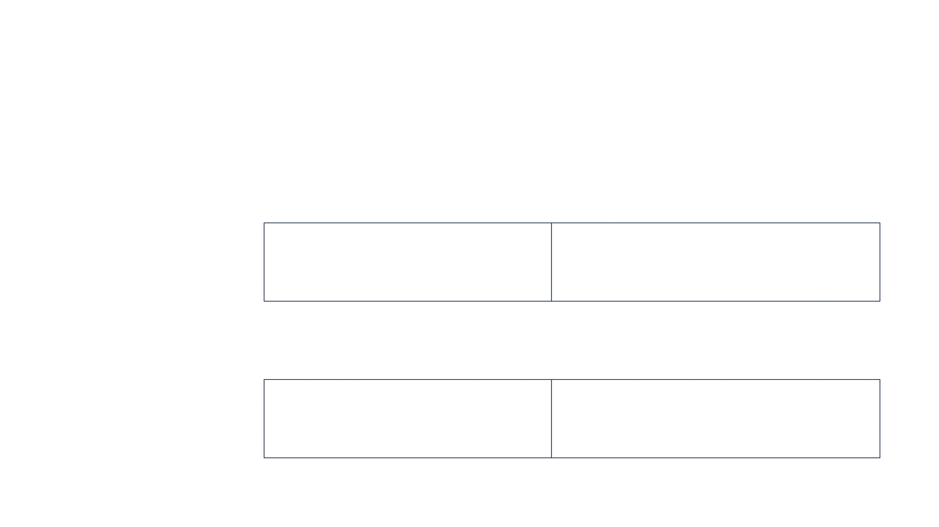
Three Implementation Options for 23a Reporting
Option
Description
Key Consideration
Monthly Progress
Traditional 1/12 FTE per month
Simpler; less documentation burden
Multi-Course Reporting
Full implementation of course completions
Higher FTE potential; more tracking required
Banked/Hybrid Approach
Combination of both pathways
Flexibility; requires clear documentation of each claim basis
Notes:
Building on the complexity we just discussed, districts have a few options for how they approach 23a reporting. You can stick with the traditional monthly progress method, which is simpler but might limit FTE potential. Or, you can fully embrace multi-course reporting for higher FTE, but that means more tracking. A hybrid approach offers flexibility, but you'll need clear documentation for each claim. Each option has different documentation expectations and risks.

Slide 18
System Delays Do Not Change Statutory Obligations
CEPI system updates lagged behind statute earlier in the year.
Critical principle: System limitations do not change statutory requirements.
CRITICAL PRINCIPLE
Districts are still responsible for meeting established deadlines.
System Limitations ≠ Statutory Exemptions
Districts must satisfy the additional reporting requirements to maintain funding.

Slide 19
05
Audit Readiness
What auditors are examining — and how to be prepared
Notes:
Now, let's shift our focus to audit readiness. This section will cover what auditors are specifically looking for and how you can best prepare your district. We'll examine the key areas where districts often face challenges and how to ensure you're well-positioned for a successful audit.

Slide 20

Misuse of Forgiven Days Is a Leading Financial Risk
Misapplication of forgiven days is one of the biggest financial risks seen across the state.
FINANCIAL RISK
Additional Forgiven Days Cannot Offset Low Attendance
Districts sometimes assume additional forgiven days can offset attendance issues — this is not allowed.
Misuse can result in direct funding loss and audit findings.
Review your district's forgiven day usage against actual attendance data.
Notes:
Misapplication of forgiven days is a major financial risk we're seeing across the state. Districts sometimes assume they can use these days to offset attendance issues, but that's simply not allowed. This misuse can lead to direct funding loss and significant audit findings. You really need to review your district's forgiven day usage against actual attendance data. This is a critical area for financial stability.

Slide 21
Calendar Design Is a Potential Compliance Issue
Testing days, virtual days, and PD days must all align with statutory requirements.
PLAN AHEAD CHECKLIST
Calendar structure is being reviewed as part of audits — not just instructional day counts.
Ensure these are addressed before the year begins:
Testing structure aligned with statute
✓
Virtual days properly documented
Plan ahead: Retroactive corrections are difficult and may not be accepted.
✓
PD days board-approved with advisory committee
✓
Notes:
Calendar design itself is now a compliance issue, not just an instructional one. Testing days, virtual days, and professional development days must all strictly align with statutory requirements. Auditors are now reviewing your entire calendar structure, not just the count of instructional days. So, planning ahead is absolutely critical here; retroactive corrections are very difficult and often not accepted. This builds on our discussion of financial risks, showing how operational details directly impact compliance.

Slide 22
System Outputs Are Not Proof of Compliance
There is a tendency to rely on system-generated reports as evidence of compliance.
"Reporting ≠ Compliance. Documentation matters."
This is not sufficient. Audits examine underlying documentation and actual practice.
The question is not "what does the system show?" — it is "what actually happened, and can you prove it?"
Notes:
It's easy to fall into the trap of relying on system-generated reports as proof of compliance. But I need to be clear: this is not sufficient. Audits delve much deeper, examining the underlying documentation and actual practice. The real question isn't what your system shows, but what actually happened, and can you prove it? This means documentation truly matters, far beyond just what your software outputs.

Slide 23
Areas that you should spend a little extra time on….
01
02
Attendance Calculation Issues
23a Documentation Gaps
Errors in daily threshold application
Missing or incomplete claim basis records
03
04
Virtual Program Structure
Teacher Assignment Alignment
Insufficient evidence of interaction and engagement
Mismatches between assigned and reported roles
Notes:
We're seeing some consistent audit findings across the state, and it's important to be aware of them. These include errors in attendance calculations, specifically with daily threshold applications. We're also finding significant documentation gaps for 23a claims, where the basis for the claim is missing or incomplete. Virtual program structures often lack sufficient evidence of student interaction and engagement. And finally, there are frequent mismatches between assigned and reported teacher roles. Understanding these common pitfalls can help you proactively address them.

Slide 24
Audits Focus on Alignment Between Data, Documentation, and Practice
Audits are increasingly focused on alignment across three layers.
1
Data
What the system shows
Any gap between these three creates audit risk.
↓
Program integrity and data consistency are the two most scrutinized dimensions.
2
Documentation
What records support
↓
3
Practice
What actually happened
Notes:
Building on our discussion of common audit findings, it's crucial to understand the core principle guiding auditors: alignment. They're looking for consistency across your data, your documentation, and your actual practices. If what your system shows doesn't match your records, or if your records don't reflect what truly happened, you've got a significant audit risk. Ultimately, auditors are scrutinizing program integrity and data consistency above all else.

Slide 25
Five Things to Remember When You Leave Today
01
Know your claim basis
Progress vs. completion must be clearly identified for every 23a claim.
02
Attendance drives funding
Every day matters; 75% is a hard daily threshold.
03
Documentation matters
System outputs are not sufficient; underlying records are required.
04
Systems lag the law
CEPI delays do not change your statutory obligations.
05
Follow the statute
When in doubt, go back to the actual language of the law.
Notes:
As we wrap up, I want to leave you with five key takeaways that summarize everything we've covered today. First, always know the basis of your 23a claims; distinguish clearly between progress and completion. Second, remember that attendance directly drives funding, and that 75% threshold is a hard daily requirement. Third, documentation is paramount; system outputs alone won't cut it. Fourth, system delays don't excuse statutory obligations. And finally, when in doubt, always refer back to the actual language of the law. These five points are your roadmap to compliance this year, and now I'm happy to open it up for any questions you might have.

Slide 26

Questions & Discussion
Brian Ciloski, MDE
Jessica Beagle, MDE
Thank you for your time and commitment to compliance.
Notes:
At this point, I'm happy to take questions or talk through specific scenarios that districts are dealing with. Thank you for your time and commitment to compliance.

